Slide 1
Iron Car Final Presentation
Simon Rummert - 27.06.2017

Slide 2
What do we want to talk about?
Goals
Progress
Results
Problems
Future Work

Slide 3
Goals
Refactor and update existing Stereo-Vision code
Improve Stereo Vision Quality
Implement Collision Avoidance Algorithm

Slide 4

Goals
Refactor and update existing Stereo-Vision code
But Why?
OpenCV 3.0.0 Release Date: June 2015
Improvements over OpenCV 2.4.X:
Faster
More stable
Improved usage of multiprocessor and GPU architectures

Slide 5
Goals

Slide 6
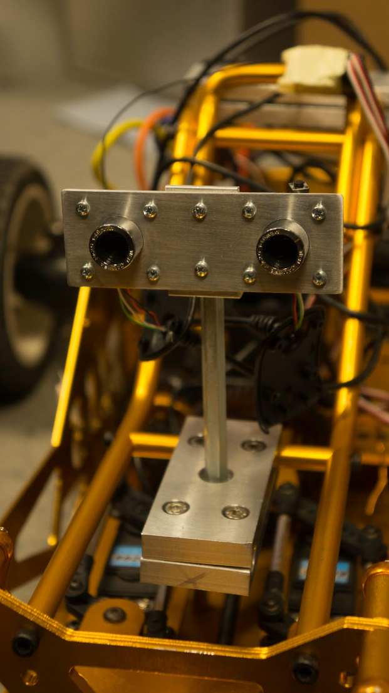
Goals
Improve Stereo Vision Quality
But Why?
Old cameras supply mediocre depth perception because:
Unsynchronized image capturing
Random frame drops on change of brightness
Only support 320x240 resolution

Slide 7
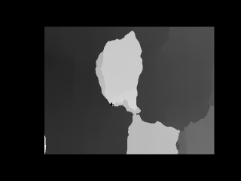
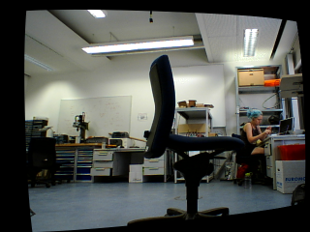
Goals
Improve Stereo Vision Quality
But Why?
We want good results even from simple Block Matching Algorithm (It is not so accurate, but faster)

Slide 8

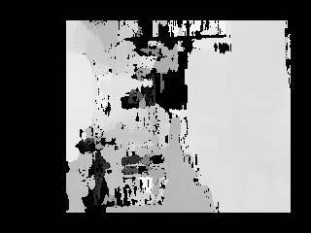
Goals
Improve Stereo Vision Quality
But Why?
We DO NOT want unsatisfying or noisy results

Slide 9
Goals

Slide 10
Goals
Implement Collision Avoidance Algorithm

Slide 11
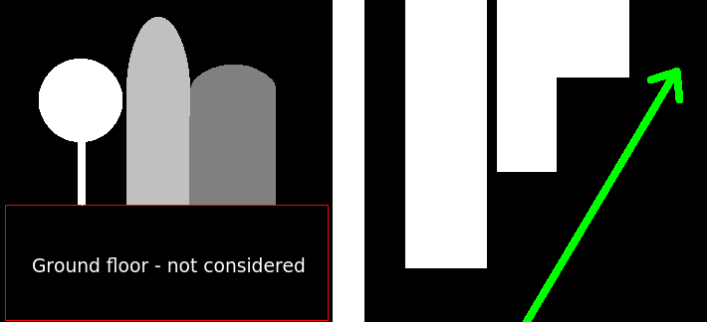
Goals
Implement Collision Avoidance Algorithm
But Why?
To avoid collisions...

Slide 12
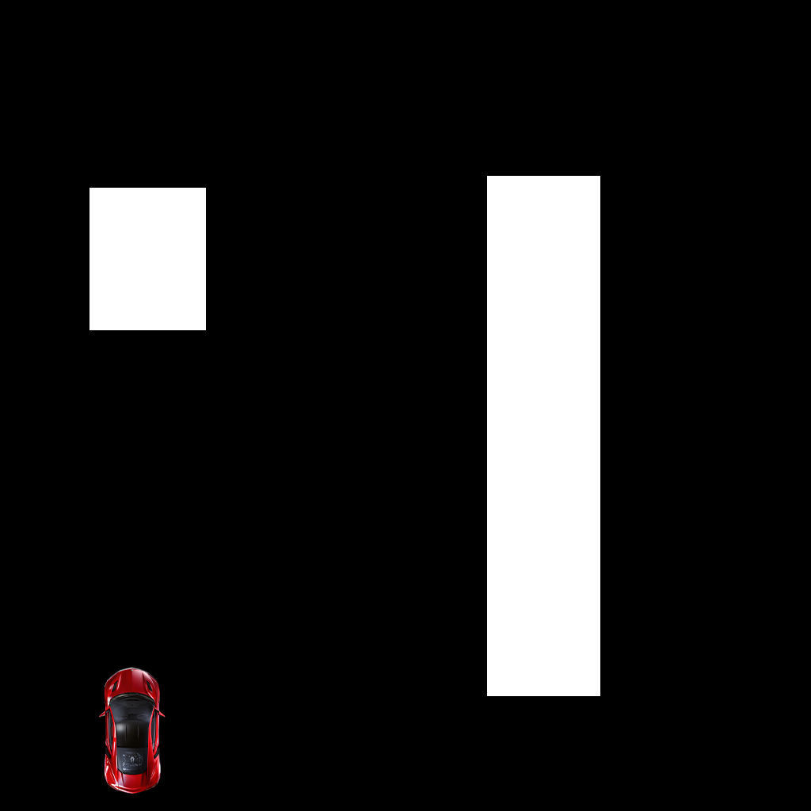
Goals

Slide 13
Progress

Slide 14
Progress
Refactoring
Update to OpenCV 3.0.0:
Relatively straight forward
Mainly changes in the cmake process
Some function parameters had to be adjusted

Slide 15
Progress

Slide 16
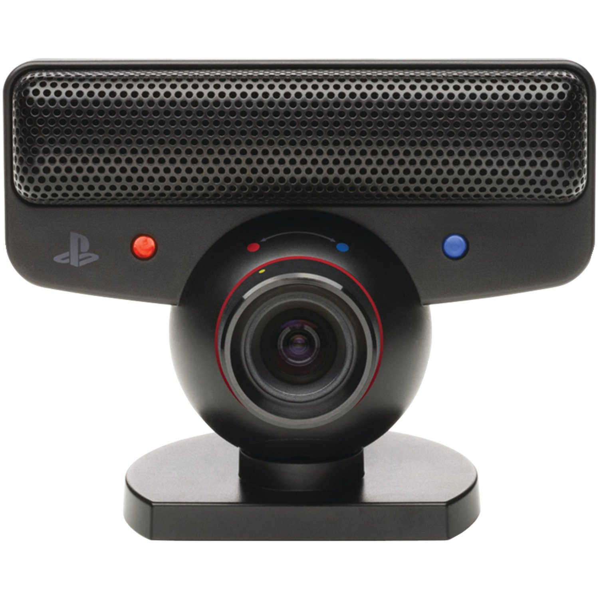
Progress
Stereo Vision Improvements
Used new cameras:
Two PS3 Eye Cameras
Cheap
Constant frame rate
640x480 at 30 FPS
Can be hardware synced

Slide 17
Progress
Stereo Vision Improvements
What is hardware sync?
- Two cameras shoot images at exactly the same time
- Resulting image pair produces better depth perception

Slide 18
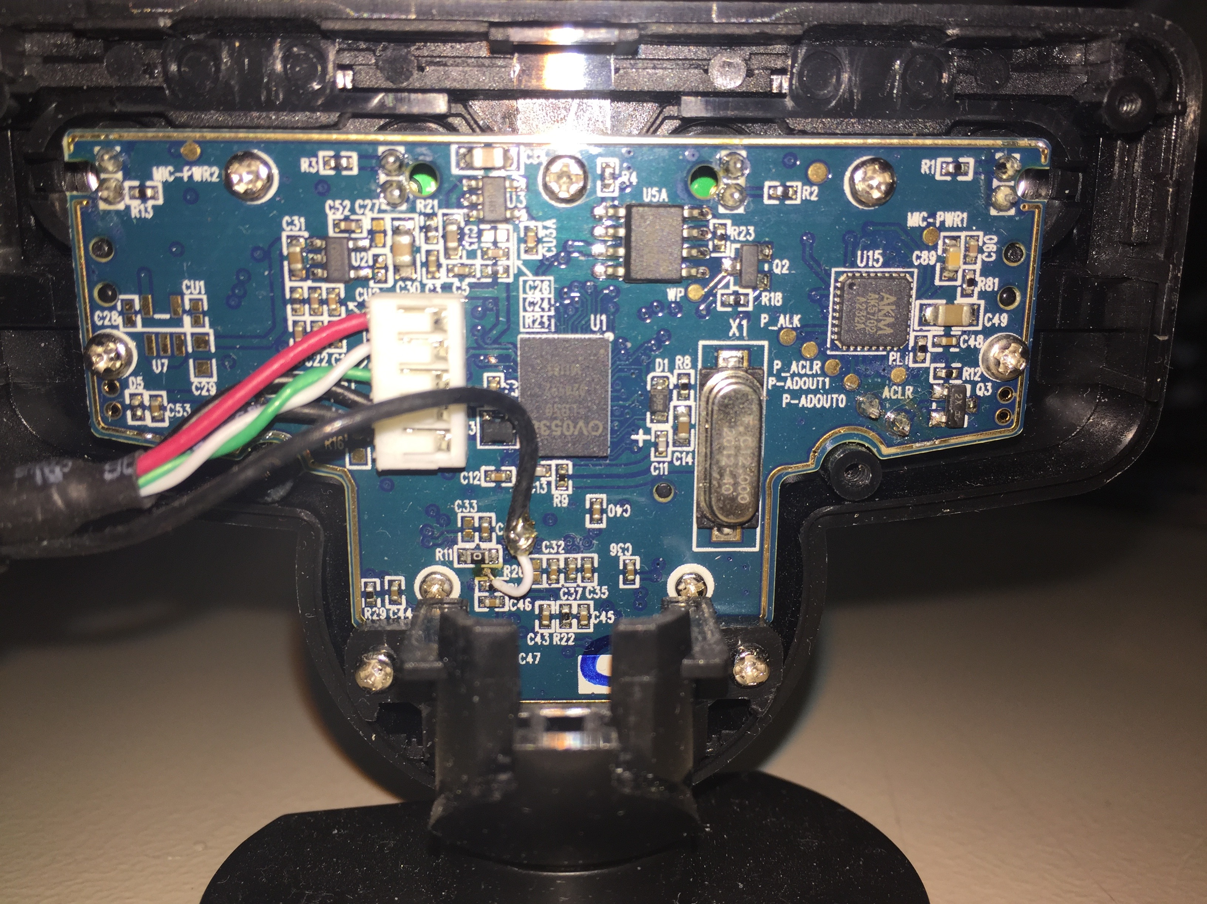
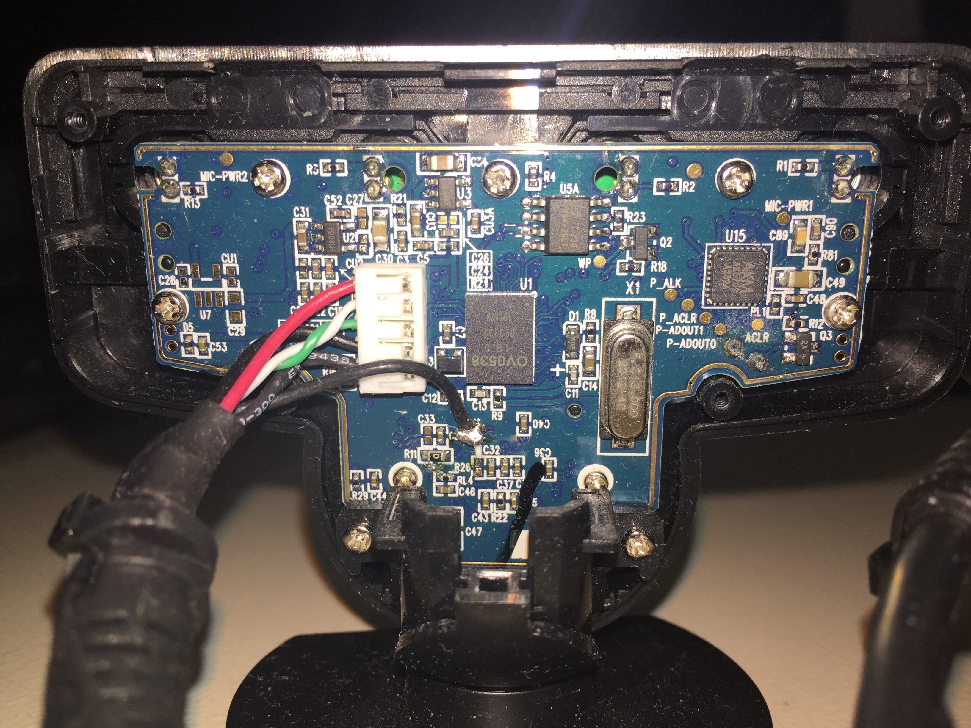
Progress
Stereo Vision Improvements
How does it work?
Left camera:
Cable soldered to VSYNC pin
Right camera:
Cable soldered to FSIN pin

Slide 19
Progress
Stereo Vision Improvements
How does it work?
VSYNC
sends signal when image is taken
FSIN
receives signal and forces camera to take image

Slide 20
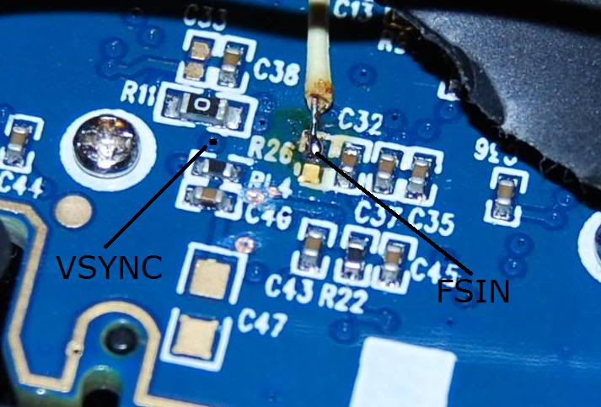
Progress
Stereo Vision Improvements
Pin locations on the board

Slide 21
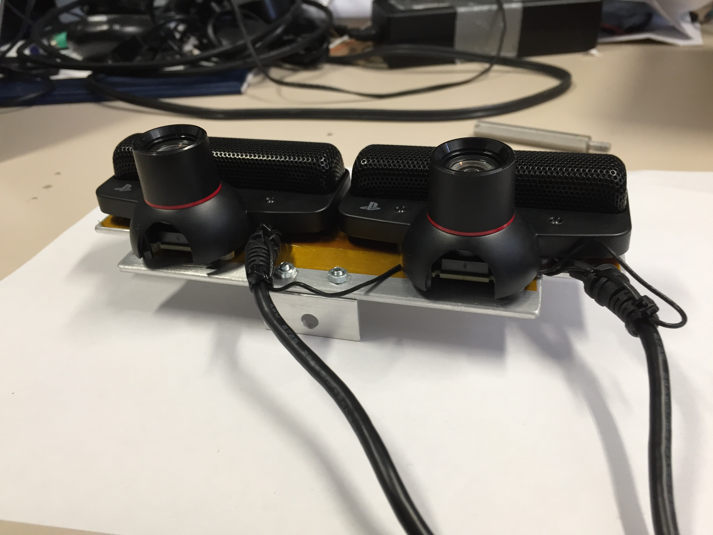
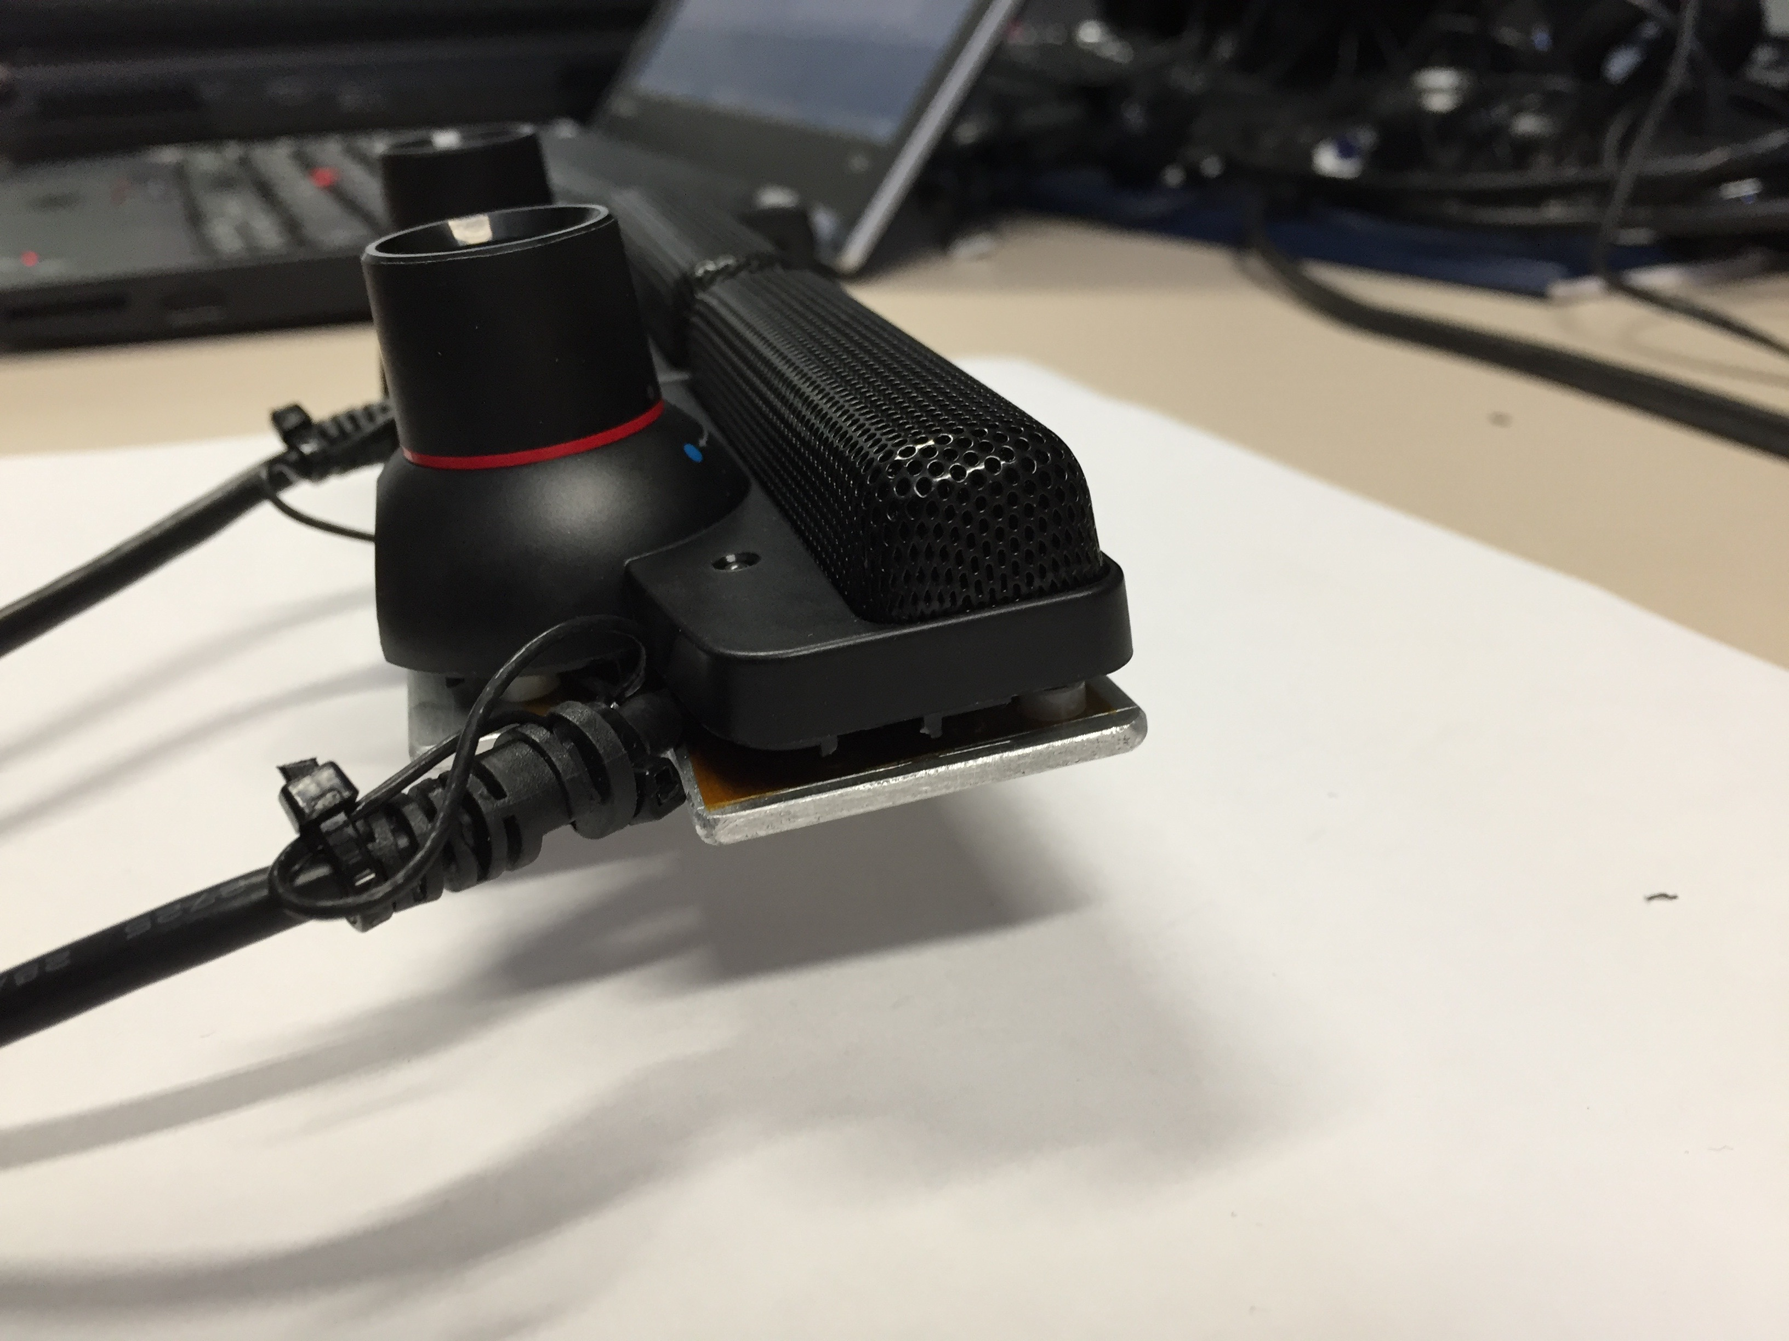
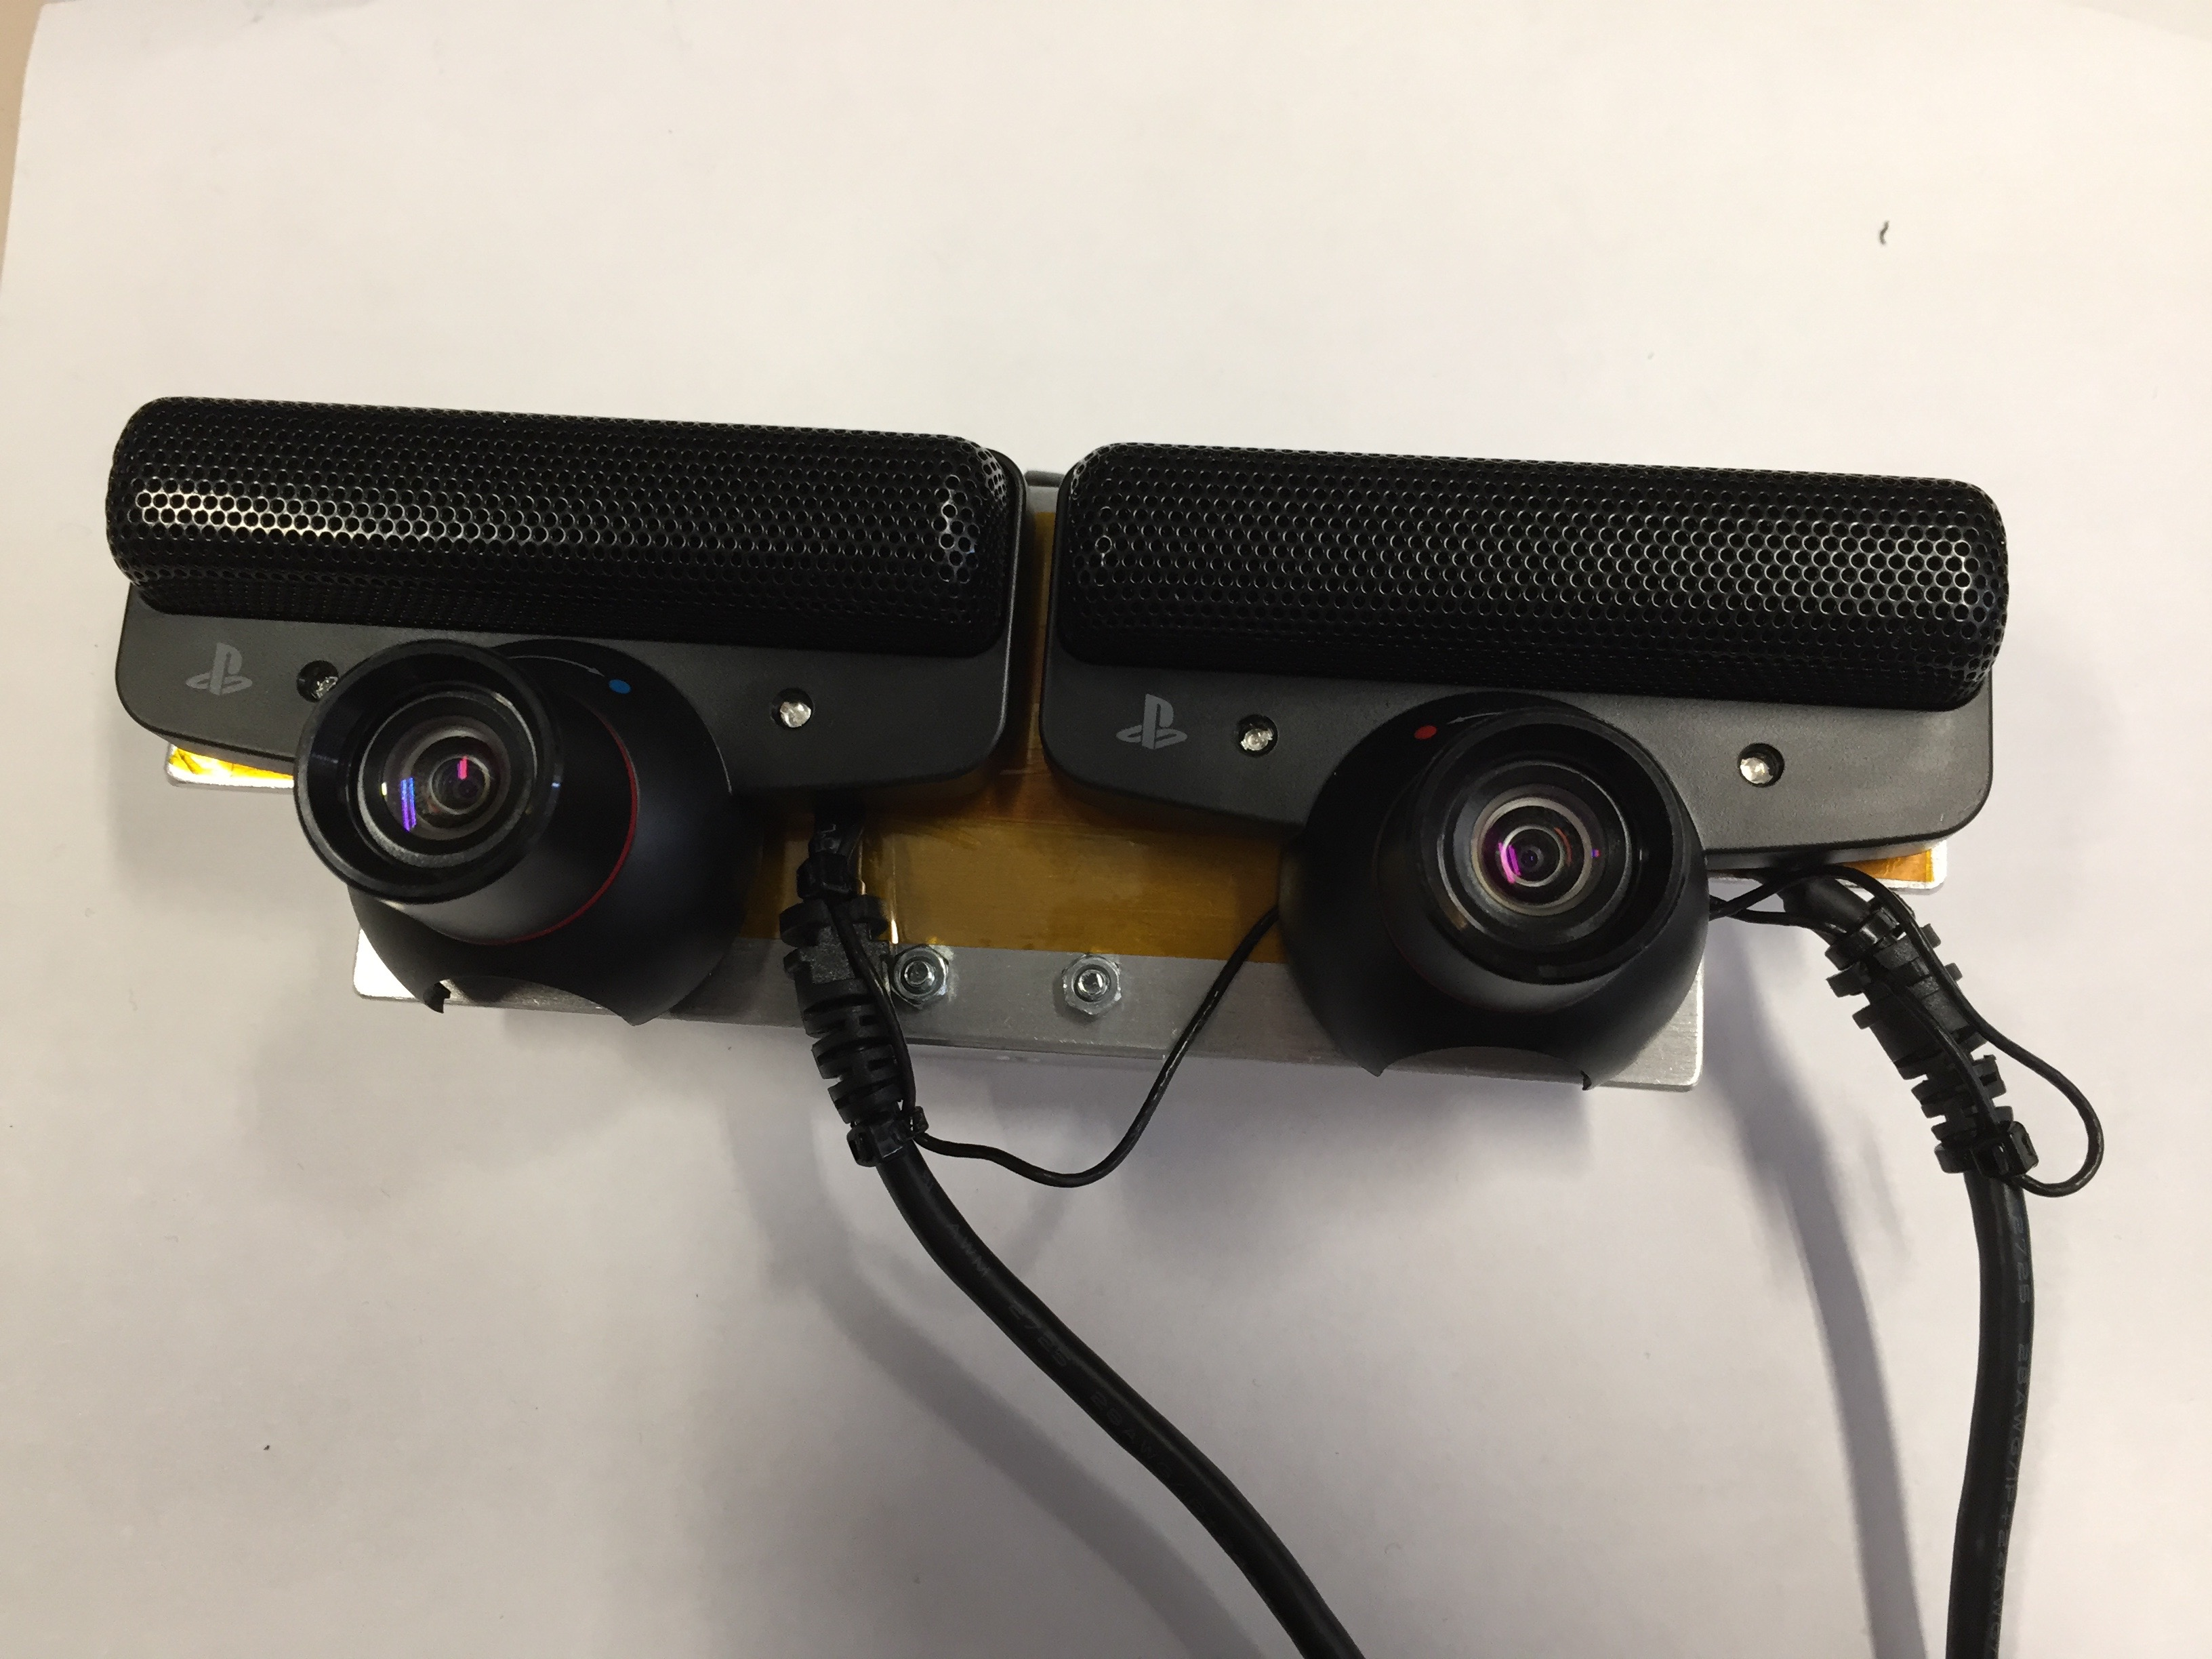
Progress
Stereo Vision Improvements
Next step: Building a Mount

Slide 22
Progress

Slide 23
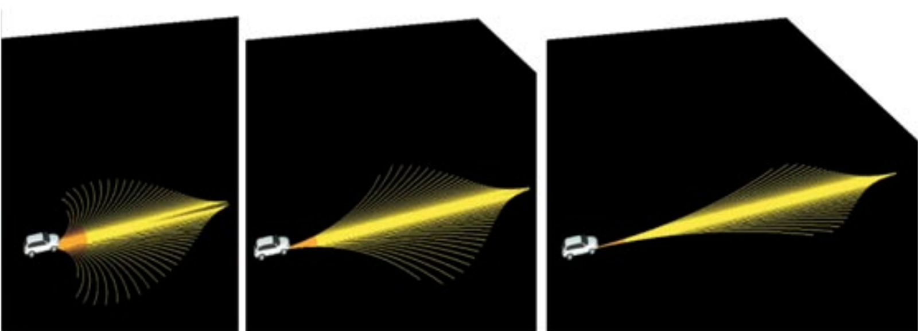
Progress
Collision Avoidance
Idea: Use Tentacles

Slide 24

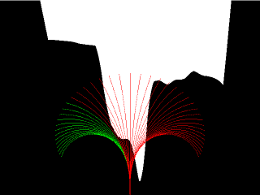
Progress
Collision Avoidance
Idea: Use Tentacles
Top View
With Tentacles

Slide 25
Progress
Collision Avoidance
Idea: Use Tentacles
With Tentacles
One Tentacle represents one steering angle
Red means collision imminent
Green means safe
Therefore: always choose green angle

Slide 26
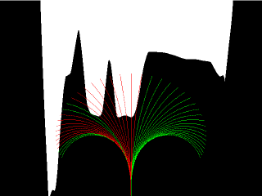
Progress
Collision Avoidance
But which safe angle should I choose?
Should I choose left?

Slide 27
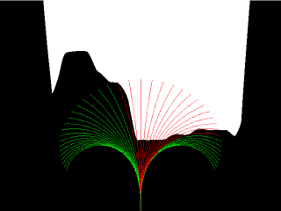
Progress
Collision Avoidance
But which safe angle should I choose?
Should I choose right?

Slide 28
Progress
Collision Avoidance
Solution: Assume collision object at the side of most intersecting tentacles
Prefering RIGHT side
Prefering LEFT side

Slide 29
Results

Slide 30
Results
Remember the goal:
Drive around the obstacles
without collision

Slide 31
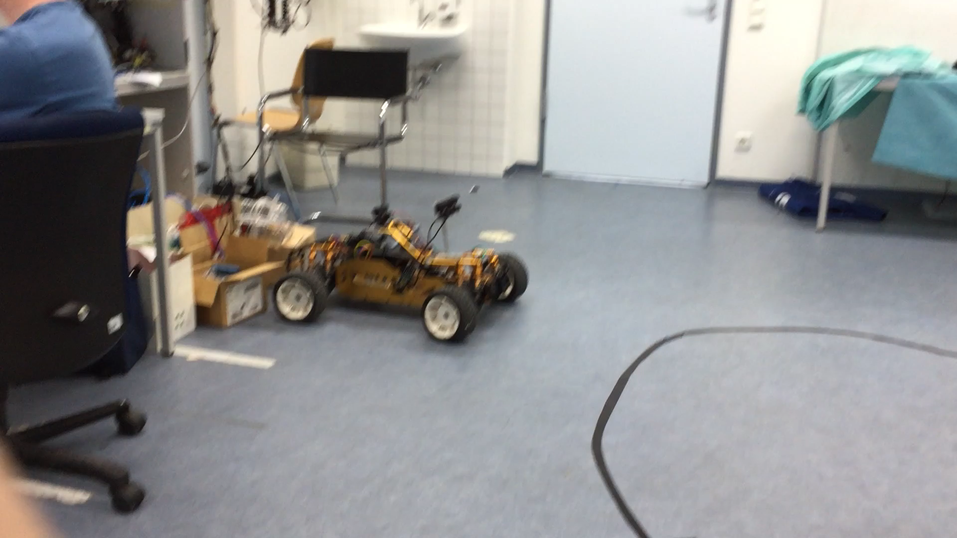
Results

Slide 32
Results
Why did the car take so long to steer?

Slide 33
Problems

Slide 34
Problems
Measurements have shown:
Depth map creation with new cameras: ~500ms per iteration
Depth map creation with old cameras: ~130ms per iteration
Why?
New cameras have 640x480 resolution
That is 2 times the resolution of the old cameras
In total: 4 times more pixels for the depth map calculation

Slide 35
Problems
Then why bother at all? Just use the old cameras!

Slide 36
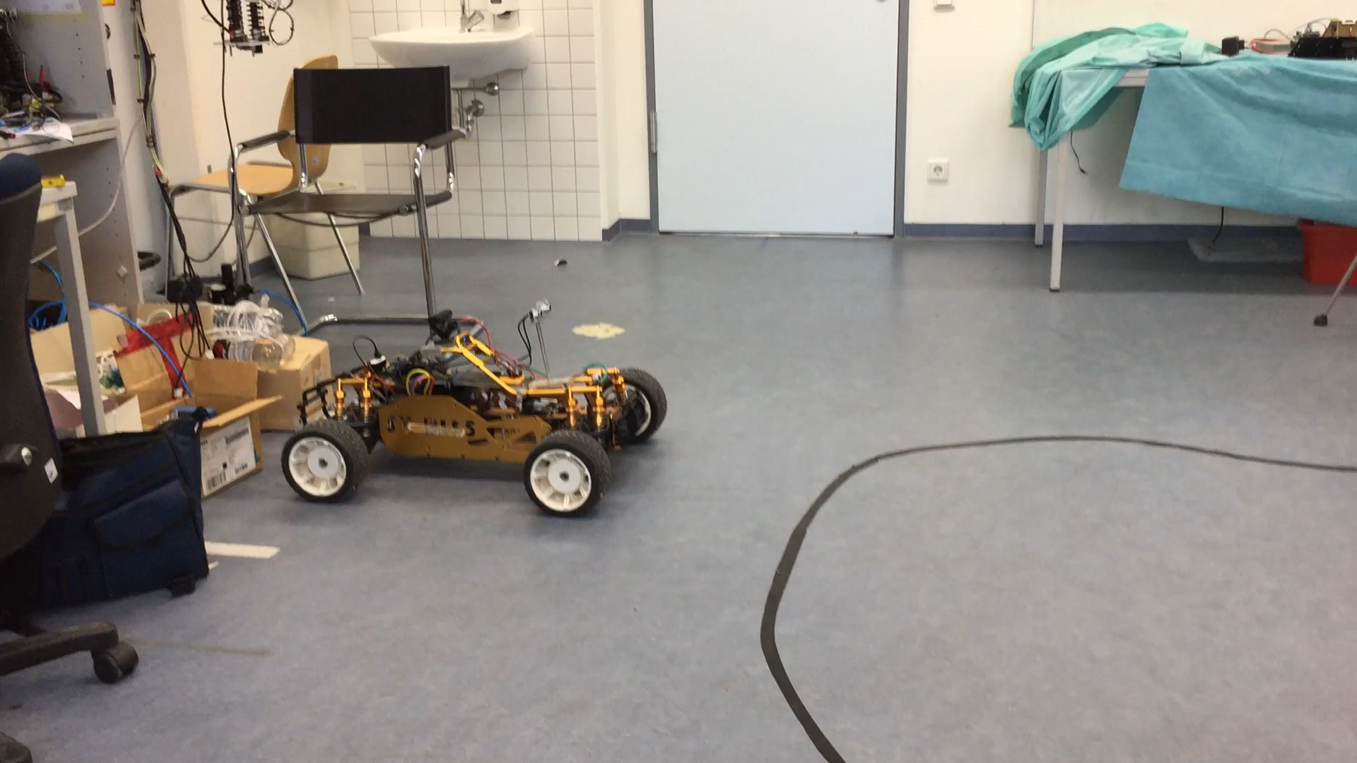
Problems
Results on the same course with old cameras:

Slide 37
Problems
Then why bother at all? Just use the old cameras!
Remember: We are using the faster, but more inaccurate Block Matching algorithm for our depth map
This means:
depth map can get too noisy
Therefore:
Turn down the sensitivity to reduce false positives

Slide 38

Problems
Then why bother at all? Just use the old cameras!
Depth map with old cameras
Depth map with new cameras

Slide 39
Problems
Conclusion
New cameras:
Pro:
More accurate depth map
Con:
- Slower calculation time
Old cameras:
Pro:
Overall faster depth map creation
Con:
- Too inaccurate

Slide 40
Future Work

Slide 41
Future Work
Use a Multiprocessing/GPU approach for improving the execution time
Use multiple threads for Image Processing
Intel‘s TBB library for multiprocessing is used by OpenCV, with workarounds also compilable on Raspberry Pi 2 and 3
Wait for OpenCL to be implemented for Raspberry

Slide 42
THE END

